Slide 1
Instructions for the Data Analysis Demos
1
You have 3 minutes to present – load your slides into PowerPoint (or whatever program you use), put it into “slide show” mode so the slides are full-screen (without the toolbar, etc.), and be ready to share your screen when your group is called. Practice first! There are five people in your group: hold a short Zoom session to practice sharing in full-screen presentation mode. We can only offer you one opportunity to present so make the most of it.
The next few slides give you all the alternatives for how to present your Data Analysis for swift feedback. Select only the slides that fit your RQ. Before presenting DELETE all slides and text (and instructions) that you do not use (including this slide). You can then enlarge your selection, so it is clearly visible on the slide.
Appointment slots will appear on Canvas soon (calendar) and will take place on Monday during your usual tutorial slots. Sign up early. When space runs out, we cannot issue any further slots. If you do not turn up at the start of your slot you will not be given another opportunity. All the group members should attend but select one person to present. DO NOT SIGN UP unless you can attend. You will not be graded on this presentation but if you do not attend your booked space, your group will have 5 points deducted from the Data Analysis assignment.
At this point we assume you are using your allocated datasets. We are not going to check during the presentation, but your assignment will not be graded if the dataset you use in the analysis has not been allocated to your group.
We look forward to giving you feedback. If your group is not presenting, still attend the tutorial as the feedback will help you too.

Slide 2
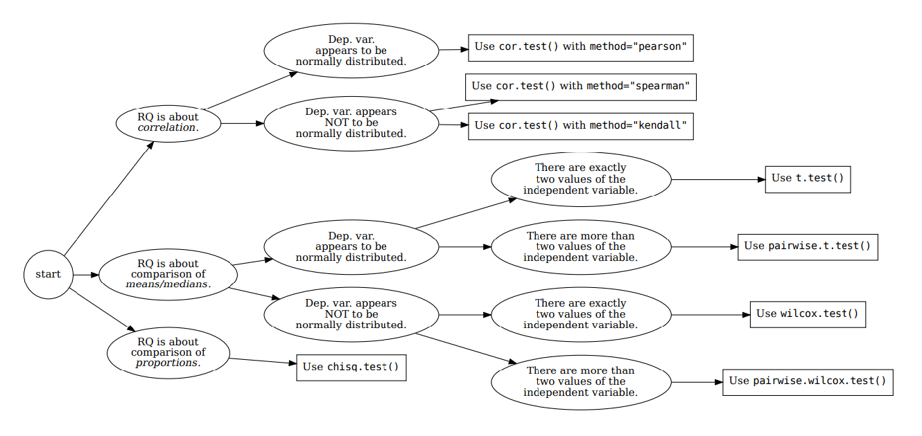







How your RQ + distribution of data (Histogram) leads to a statistical test. Visualization requirements highlighted in yellow.
Histogram & Scatterplots
Histogram and Boxplots
Stacked bar chart (no histogram)
Figure: Decision tree – how Research Questions relate to Visualizations and Statistical Test.

Slide 3

7COM1079-2022 Student Group No: AS035 Names of Student Attendees:
Mahamad Alfaiz Javidbhai, Marshal Ashokkumar Pachani, Muhammad Waleed,
Rutvik Kishorbhai Vadher, Emma Harrison
3
Group Id: A035 Name of Student Presenting:
Data Analysis – Analyzing dataset DS261 car resale prices, with the Pairwise Wilcoxon test to find if there is a difference in the mean resale price of cars between different fuel types? car Tutorial Presentation for Feedback Date:

Slide 4
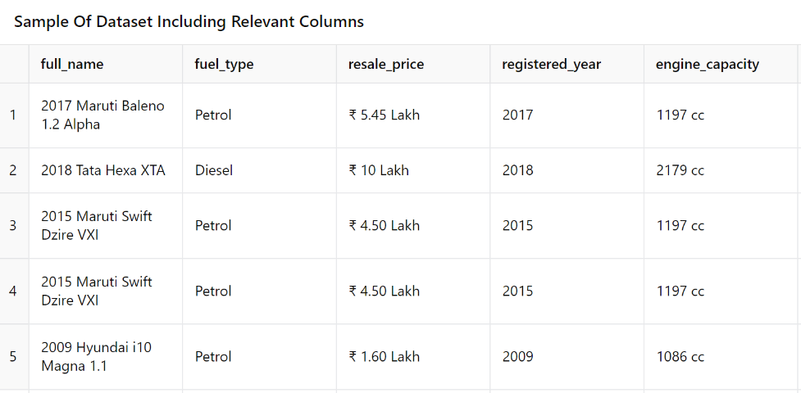
7COM1079-2022 Student Group ID:
We are using the dataset (DS261, car_resale_prices.csv) to answer our Research question (“Is there a difference in the mean resale price of cars between different fuel types?) ¹
4
Include a sample of your .csv dataset to include the column names (variables) in your RQ².
The dataset has 17,447 rows
The dependent variable is Resale price
The independent variable is Fuel type
Notes:
4

Slide 5
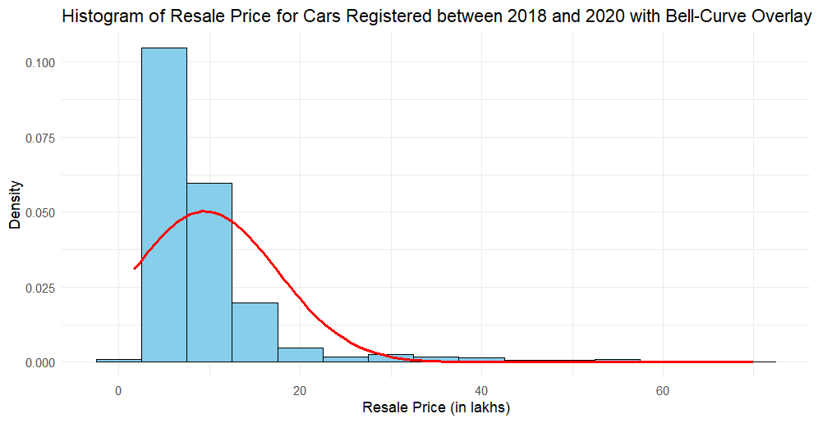
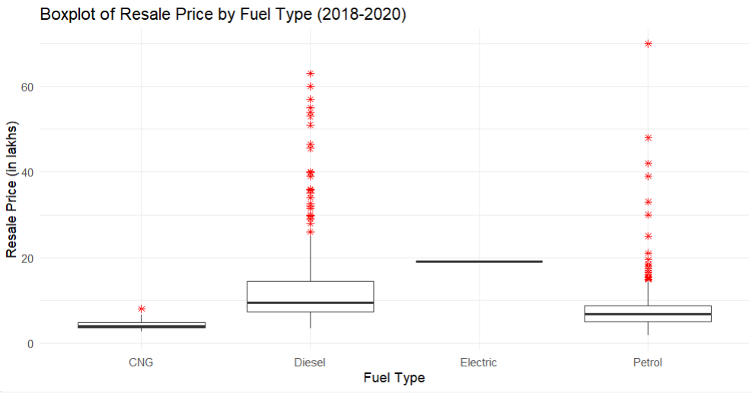
Here is a Histogram showing the frequencies of our dependent variable to include the normal curve overlay.WITH OUTLIERS
Our RQ asks about differences in means/ medians
Looking at the data from the years 2018 - 2020 only. With 75 outliers.
The normal curve overlay does not closely follow the shape of the underlying histogram, indicating that the data is not normally distributed. The histogram shows a right-skewed distribution, which is typical of car resale prices, as most cars are priced in the lower range, with fewer high-value outliers.
The normal curve overlay does not follow the shape of the underlying data, so we use the non-parametric test that does not assume normality, Wilcoxon.
5

Slide 6
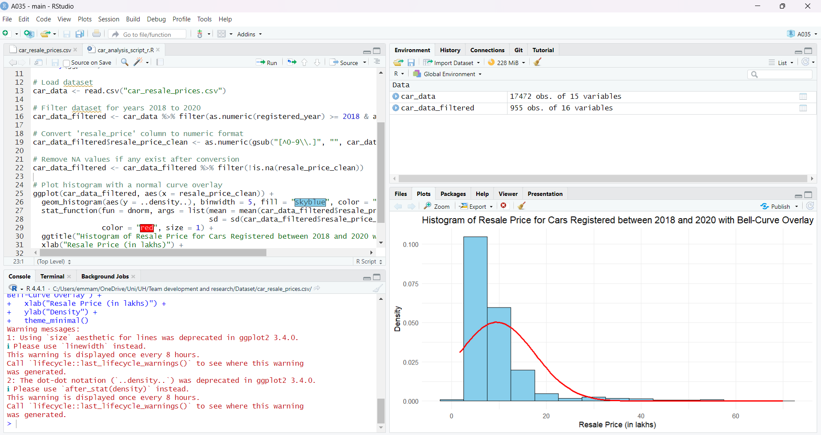
Snippet of the R code
Notes:
6

Slide 7
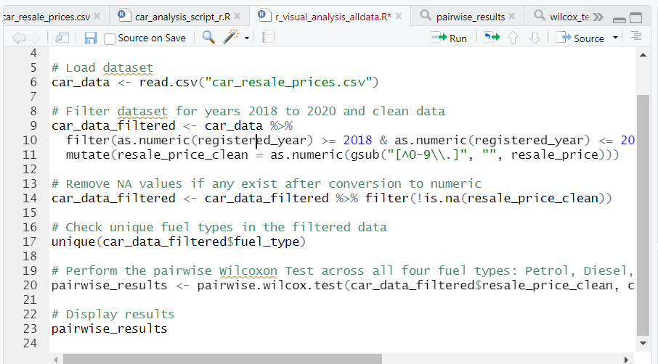
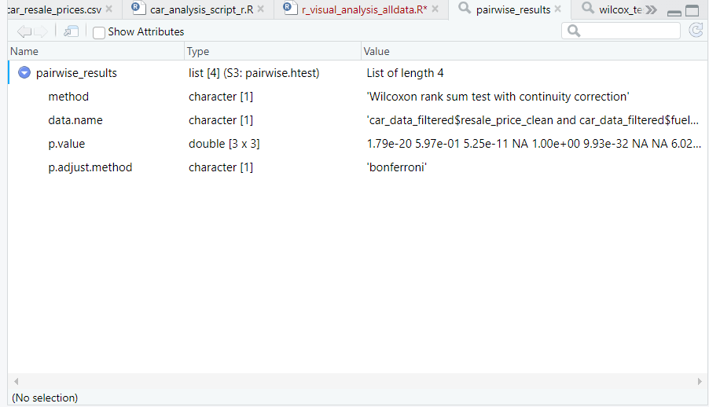
Test Type: Pairwise Wilcoxon Rank Sum Test.
The dataset has four levels for the independent variable (fuel_type): Petrol, Diesel, Electric, and CNG. Given the skewed distribution of the data (as seen from the histogram), the Pairwise Wilcoxon Test was chosen. This test allows us to compare each pair of the four fuel types to determine if there are significant differences in resale prices between these categories.
I used the pairwise wilcoxon test as there are more than two values in our independent variable. Snippet of the R code you use to calculate my test statistic.
Notes:
7

Slide 8
R Script and Results – The Analysis
PRE 7COM1079-2022 Student Group No: ?????
8
P-Value Matrix:
Petrol vs Diesel: p-value = 1.79e-20 (significant)
Petrol vs Electric: p-value = 5.97e-01 (not significant)
Diesel vs CNG: p-value = 9.93e-32 (significant)
Based on the p-values from the pairwise Wilcoxon test, we reject the null hypothesis for most fuel type pairs, indicating that the resale price differs significantly between many of the fuel types.
Since most p-values (e.g, Petrol vs Diesel and Diesel vs CNG) are less than 0.05, we have significant differences between these fuel types in terms of resale price. For Petrol vs Electric, the p-value is greater than 0.05, suggesting no significant difference between these two categories.
The fuel type impacts the resale value of cars, especially between Diesel vs CNG and Petrol vs Diesel. However, there is no significant difference between Petrol and Electric cars in terms of resale value. These results are useful for buyers and dealers because, buyers might prefer certain fuel types over others to maintain higher resale value. Dealerships can use this analysis to set competitive pricing for cars based on their fuel types and expected depreciation.
Notes:
8

